Slide 1
Predictive Analysis On Employee Turnover Rate
Team Members:
Monika Vurigity
Shamini Puthooppallil Baby

Slide 2


RESEARCH GOAL
PROBLRM STAETEMENT:
Employee turnover is a problem faced by all organisations
Prediction of turnover can contribute productivity of employer.
INITIAL QUERIES:
What are the reasons behind Turnover?
Why its important for Organizational Development?
How can we reduce turnover rate?

Slide 3
METHODOLOGIES
Data Retrieval:
Cloud storage Electronic Employee records
Data preparation and exploration:
Cleansed raw data
Data modelling:
Finalised the target value and features(RFE)
Classification
K Nearest neighbour Decision Tree
Neighbours=5 metric= 'manhattan’ | Criterion=‘gini
Leaf size=40 weights= 'distance' | Maximum leaf nodes=90

Slide 4
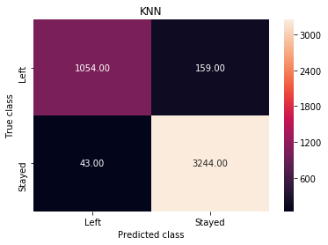
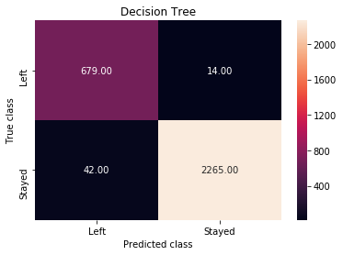
RESULTS
K Nearest Neighbour Classifier Accuracy=95.51 | Decision Tree Classifier Accuracy=98.13
Outcomes:
Turnover of Employees can accurately predictable from the given factors
Turnover prediction can contribute major percentage of organizational productivity

Slide 5


